Slide 1
The Boring Layer: What AI Is Building On, and Who Owns It
Madelyn Olson, Valkey maintainer

Slide 2
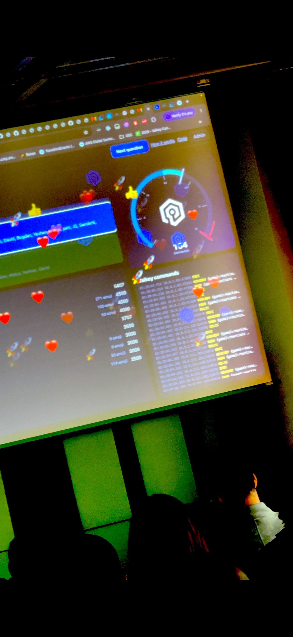
Everyone is building their own software
Notes:
I’m a database engineer. I’m not very good at building front end software. One of the things we wanted for the Valkey conference we had on Monday was some trivia. To make, content. So I built this silly trivia game, to let the attendees interactively guess obscure Valkey trivia and spam the screen with Emojis. Classic.
AI made this possible.
AI is great.
You know why AI is great.

Slide 3
AI won't say no
Notes:
AI will happily try to build whatever silly little app you’re trying to build.
It will happily go and make all sorts of infrastructure changes. All of those boring infrastructure changes.

Slide 4
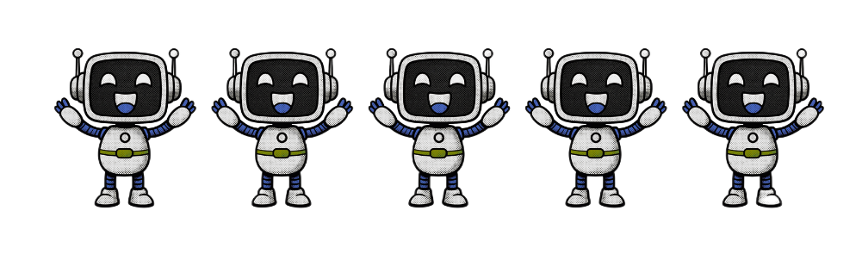

1 in 6 AI agents built their own cache
Notes:
482 of 2,900 answers were custom or DIY instead of an existing store.
Source: Amplifying.ai Valkey benchmark, 1 September 2026. 5 models, 4 repos, 100 prompts, 2,900 answers. No prompt mentions Valkey. https://chorus.aws.dev/doc/1q6EixyPkWpq/Amplifyingai---Valkey-Benchmark-Results

Slide 5
AI will make unstable infrastructure choices
Notes:
Ask the same question twice and you can get a different answer. In 118 of 297 model, repo and prompt combinations where Valkey was picked at least once, it was picked in only one of the two runs.
Agents weigh the license only when the prompt raises it: Valkey is the pick in 16% of all answers and 66% of licensing prompts.
Source: Amplifying.ai Valkey benchmark, 1 September 2026. 5 models, 4 repos, 100 prompts, 2,900 answers. No prompt mentions Valkey. https://chorus.aws.dev/doc/1q6EixyPkWpq/Amplifyingai---Valkey-Benchmark-Results

Slide 6
You're responsible to maintain your software
Notes:
Personalized software has no maintainer, and the AI that built it doesn't know how to be one. That leaves you.

Slide 7
Maintainers say no
Notes:
It's not no to contributing. It's no to bad ideas.
Vector sets, valkey-io/valkey#2569. Redis shipped them in April 2025 and Valkey still hasn't. Madelyn, 2 September 2025: "One thing I see missing from this thread, to my surprise, is what problems we are concretely trying to solve."
Ping Xie, valkey-io/valkey#274, 2024: "Often, removing a feature is far more challenging than adding one."
557 Valkey pull requests closed without merging, 2,294 merged (GitHub search, 7 October 2026). Not every close is a deliberate no.

Slide 8
You should channel your inner maintainer
Notes:
Ask what problem it solves before letting the AI build it. Agents follow the constraint when you give it: when policy requires permissive licensing and neutral governance, 18 of 20 answers pick Valkey.
Source: Amplifying.ai Valkey benchmark, 1 September 2026. 5 models, 4 repos, 100 prompts, 2,900 answers. No prompt mentions Valkey. https://chorus.aws.dev/doc/1q6EixyPkWpq/Amplifyingai---Valkey-Benchmark-Results

Slide 9
AI is writing a lot of your software.
Make sure it's building on a good foundation.
Notes:
Proven, vendor neutral open source. One owner can change the terms: Redis left BSD on 20 March 2024, and the Valkey repo was created 22 March 2024. Contribute back, and the maintainers carry your changes with you.

Slide 10


Learn more about Valkey
valkey.io
Trivia
Notes:
valkey.io: https://valkey.io. Trivia: https://d3pojgfcwxoi3q.cloudfront.net/trivia. Made with madelynolson.com/qr-generator, decoded with CoreImage to confirm.

Slide 11
Thank you!
Madelyn Olson
Valkey maintainer · Principal engineer at AWS

